Slide 1


Term project report Met CS 633 OL spring 2018
Group: Zac(3)
Giuseppe Vaccaro Michael Smith Yigit Katkici
Patty Thrall Gabriel Rua
Team Members:
Notes:
Smart Phone image created with https://placeit.net/stages/frontal-mockup-of-a-white-iphone-6-plus-over-a-transparent-background-a11471
FitForMe Logo created with https://www.tailorbrands.com/

Slide 2
Project Overview

Slide 3
Project Overview
Project: | Fit For Me, a Fitness and Health Website and App
Objective | To create a web-based application for users to create an account and enter body measurements and current reps in the gym, then users can go in and create new entries showing their improvements from their previous entries.
High Level Customer Features | Design workout routines Establish and track progress toward goals |  |  |  | Measure performance Integrated exercise reference guide | In-app meal planner Find training partners and personal trainers
Project Team |  |  |  | Milestones
Katkici, Y. |  | Developer |  | Concept & Scope Defined |  |  | Jan 23
Rua, G. |  | Requirements |  | Personas & Requirements Defined |  |  | Jan 30
Smith, M. |  | Developer |  | Estimation Review & CI List |  |  | Feb 6
Thrall, P. |  | PM |  | Use Cases & Interactions Defined |  |  | Feb 13
Vaccaro, G. |  | Tester |  | Mock-ups & Wireframes |  |  | Feb 20
 |  |  |  | Testing & Launch |  |  | Feb 27

Slide 4
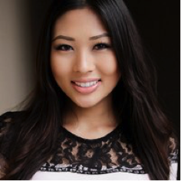




User Personas
 | Customer User | Trainer User | Administrator | Automation User | Meal Prep Tracker
Goals | Erica wants to find a place to log her accomplishments when she goes to the gym hoping to find motivation to get into the gym at a more consistent basis | Caroline wants to be able to create workout sessions and help people with their fitness goals | Mike wants to onboard as many customers as possible by introducing workouts and trainers to customer users on a user-friendly site | The automaton performs routine tasks such as resetting user passwords and managing the interface between the application and 3rd party components | The meal prep tracker is responsible for monitoring nutritional intake, proposing diet plans and providing other guidance to customers in light of their goals
Background | 25 year old, employed full time. Has a significant other with one dog Loves to play tennis Occasionally goes to the gym. It is difficult to find the time | Has been a personal trainer for over 20 years Expertise in Yoga (all levels), endurance training, dance, gymnastics, weightlifting, spinning Currently training in Washington | Mike is a computer programmer Mike created this website application | Create customer user account and trainer user account Ability to help customer users | Ability to calculate numbers Provide numbers for customer users
Scenarios | Erica is not technical and wants a user friendly website Erica would like to have easy access to the website as she would otherwise not log in | Caroline needs a website to be able to feedback to her clients about their fitness journeys Caroline would like to have an easier way to communicate | Continue to update the website Receive feedback to improve the user experience | Create account when customer joins Provide new password when customer requests one Delete account upon customer requests | Provide how many calories the customer user should be eating per weight goals Provide how many calories are left for the day for the customer user

Slide 5
Requirements

Slide 6
Requirements
ID | Story | Persona
154705116 | As a customer I want the application to measure performance during cardio sets so that I know whether I am becoming better at aerobic exercises | Erica
154705114 | As a customer I want the application to track my performance during strength sets so that I know whether I am becoming better at anaerobic exercises | Erica
154705109 | As a customer I want to be able to combine selected exercises into routines so that I can plan a workout that corresponds to my health goals | Erica
154705117 | As a customer I want to be able to enter a goal that I want to reach within a specific time window of weeks or months so that I can keep track of my progress toward that goal | Erica
154705102 | As a customer I want to be able to enter workout schedule by day and muscle group so that I can share it with potential partners and trainers. | Erica
154705128 | As a customer I want to be able to export data to multiple formats, e.g. Excel, csv, XML in order to be able to perform ad hoc analysis and reports not available in the application. | Erica
154705146 | As a customer I want to be able to keep a food intake diary so that I can understand whether my food choices support my nutritional goals | Erica
154705125 | As a customer, I want a link to videos or graphics showing correct form for an exercise so that I can learn and ensure safe and correct execution of the exercise | Erica
154705111 | As a customer, I want the application to track the number of reps that I can do of a certain weight by type of exercise and muscle group so that I can gauge whether I am becoming stronger | Erica

Slide 7
Requirements
ID | Story | Persona
154705153 | As a customer, I want to be able to note strengths and weakness during a workout so that I can learn where I'm doing well and where I need to improve | Erica
154705154 | As a customer, I want to be able to add notes to a specific workout so that I can track such variables as mood, location, and training partner and how they affect my workout routine. | Erica
154705127 | As a customer, I want to be able to import from external data source, e.g. Excel, so that I can combine data not stored in the application with data that exists there | Erica
154705150 | As a customer, I want to be able to load pictures for a specific date or workout so that I have a visual record of my progress towards a goal. | Erica
154705142 | As a customer, I want to be able to match the duration of my workout to a playlist of music so that I do not have to look at my watch during the routine. | Erica
154705135 | As a customer, I want to be able to periodically enter body measurements so that I can evaluate whether I am progressing towards my goals. | Erica
154723101 | As a customer, I want to be able to provide feedback on the application so that design, support and administration teams receive my suggestions for improvements. | Erica
154705103 | As a customer, I want to be able to select from a pre-existing list of available exercises so that I can readily build a workout routine | Erica
154705138 | As a customer, I want to see a graphical display of my performance so that I have an easy method for identifying a trend. | Erica

Slide 8
Requirements
ID | Story | Persona
154705137 | As a customer, I want to see a graphical display of body measurements history so that I have a clear visual indicator of my progress over a specific time period. | Erica
154705131 | As a customer, I want to select from a known list of predefined workout routines so that I do not have to come up with one myself. | Erica
154722814 | As a trainer, I want to be able to find other people using the app so that I can offer them my professional services | Caroline
154722845 | As a trainer, I want to be able to see my customers' performance history and goals so that I can recommend specific workout and dietary actions that support their goals | Caroline
154706518 | As the administrator I want to be able to see the full list of customers so that I can ensure system resources match projected user base needs | Mike
154706521 | As the administrator, I want to be able to delete an account so that the current list of users corresponds to desired and active accounts | Mike
154706524 | As the administrator, I want to be able to update a user account so that I can keep the records current | Mike
154706538 | As the automaton for the application, I need to be able to generate and send a new password so that the user can regain access to the application in case of forgotten passsword | Automation
154706540 | As the automaton for the application, I need to be able to send the user an email confirming registration so that the user knows the registration succeeded. | Automation

Slide 9
Requirements
ID | Story | Persona
154705133 | As the automaton, I need the user to enter age so that I can correctly perform calculations related to necessary food intake and body mass. | Automation
154705132 | As the automaton, I need the user to select a gender so that I can correctly perform calculations related to necessary food intake and body mass. | Automation
154705118 | As the automaton, I need to be able to track performance against a user's goal(s) so that I can alert him to progress at defined milestones, for example 25% of goal reached. | Automation
154705152 | As the automaton, I need to interface to a food database with calories of common food and portions so that the user can make decisions regarding food choices that appropriately support the user's weight-loss or weight-gain goals. | Automation
154705126 | As the automaton, I need to interface to external devices such a smart phone or fit bit so that I can recognize and record when the user is performing certain exercises without the user having to input the data. | Automation
154705121 | As the automaton, I want to present the user an estimate of calories burned so that the user knows whether s/he is reaching the goals for a particular session | Automation
154722942 | As the Meal Prep Tracker User, I need to be able to suggest to the user a daily or weekly meal plan that supports the goals the user has entered into the application | Meal Prep
154722899 | As the Meal Prep Tracker, I need to be able to calculate the nutritional values of a meal so that the user knows how many calories, carbs, etc s/he has ingested. | Meal Prep
154722975 | As the meal prep user, I need to be able to keep track of the user's daily meal intakes so that I can inform the user of remaining nutritional requirements for the day. | Meal Prep

Slide 10
Configuration Items List
Item No. | Configuration Item Name | Version | Submission Date | Owner | Repository
1 | Scope Document | 1.0 | 2018-01-22 | Patty Thrall | GitHub
2 | Definition of Users | 1.0 | 2018-01-22 | Patty Thrall | GitHub
3 | Engineering Requirements List | 2.0 | 2018-02-11 | Gabriel Rua | PivotalTracker
4 | Estimation Record | 1.0 | 2018-02-06 | P. Thrall & G. Rua | GitHub
5 | Definition of Use Cases | 1.0 | 2018-02-12 | P. Thrall & G. Rua | GitHub
6 | Front-end Application Development | N/A | N/A | Michael Smith | GitHub
7 | Back-end Application Development | N/A | N/A | Yigit Katkici | GitHub
8 | Test Cases | N/A | N/A | Giuseppe Vaccaro | GitHub
9 | Defect Tracking – Test Cases | N/A | N/A | Giuseppe Vaccaro | GitHub
10 | Defect Tracking – Peer Review | N/A | N/A | N/A | GitHub
11 | Configuration Item List | 2.0 | 2018-02-12 | Giuseppe Vaccaro | GitHub
12 | Interaction Diagram | 1.0 | 2018-02-12 | Yigit Katkici | GitHub
13 | State Transitions | 1.0 | 2018-02-11 | Giuseppe Vaccaro | GithHub

Slide 11
Estimation Record
 |  | Size Measure | Typical Effort per Size Measure (person hours) | Size | Effort Person/Hours |  | Final (Fibonacci) | Actual
 |  |  |  |  | Expert A | Expert B
Requirements | Definitions of users (personas) | # roles | 0.2 | 5 | 1 | 1 | 1
 | Definition of scope and limitations | # attributes | 0.1 | 10 | 1 | 1 | 1
 | Engineering Requirements List | # requirements | 0.4 | 30 | 12 | 15 | 21
Configuration Management | Configuration Items List | # CI items | 0.09 | 13 | 1 | 0.5 | 1
Estimation | Estimation Record | # activities | 0.08 | 13 | 1 | 1 | 1
Design | State Transition Diagram | # states | 0.25 | 4 | 2 | 1 | 2
 | Definition of use cases | # use cases | 0.5 | 4 | 2 | 2 | 2
 | Definition of Fields | # fields | 0.1 | 20 | 2 | 2 | 2
 | Definition of Reports | # reports | 1 | 2 | 2 | 2 | 2
Peer Reviews | Issues from peer reviews attained | # issues | 0.16 | 25 | 3 | 5 | 5
Implementation | Defect tracking system | # User screens | 6 | 1 | 6 | 8 | 8
Test Design | Test Cases | # test cases | 0.33 | 6 | 2 | 1 | 2
Test Execution | Defects from Testing recorded | # defects | 0.3 | 10 | 3 | 3 | 3

Slide 12
Use Cases, State Transitions & Component Interactions

Slide 13
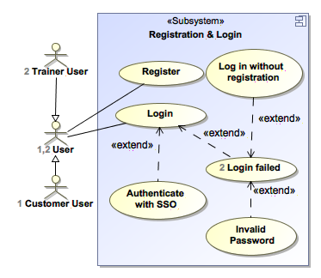
Register & Login Use Case

Slide 14
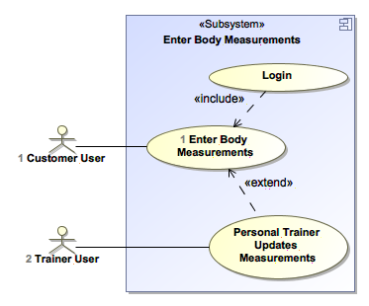
Enter Measurements Use Case

Slide 15
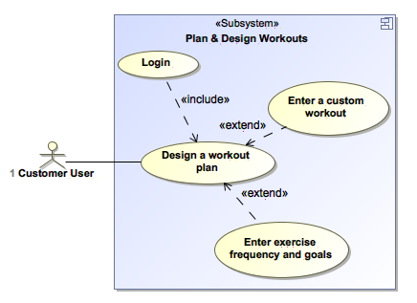
Design a Workout Use Case

Slide 16
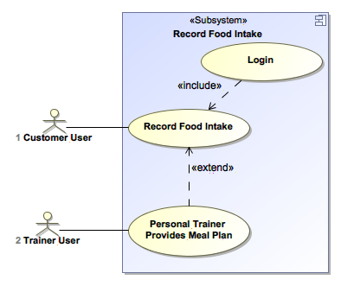
Record Food Intake Use Case

Slide 17
Register & Login State Transition

Slide 18
Workout Tracker State Transition

Slide 19
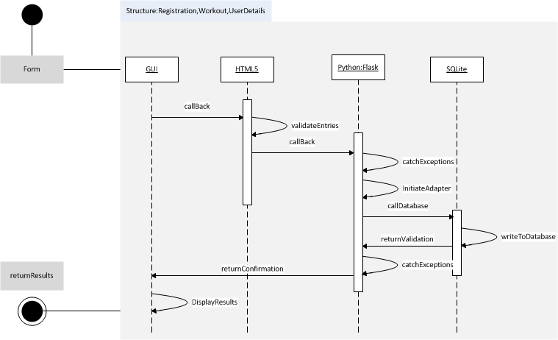
Components Diagram

Slide 20
Wireframes

Slide 21
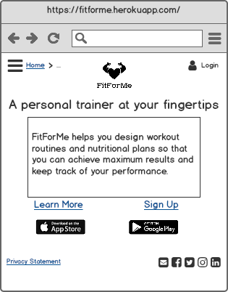
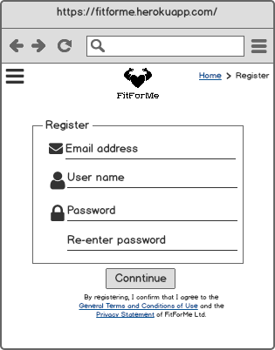
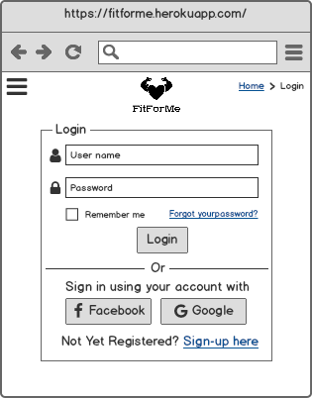
Register & Login
Homepage
Register
Login

Slide 22
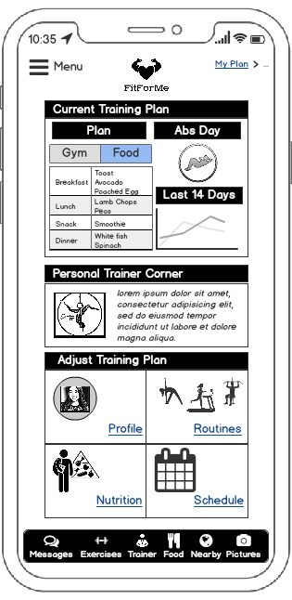
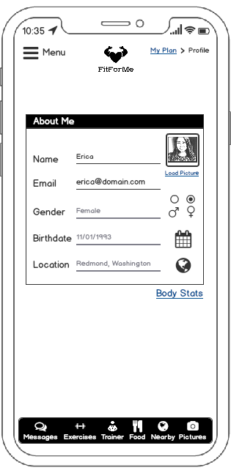
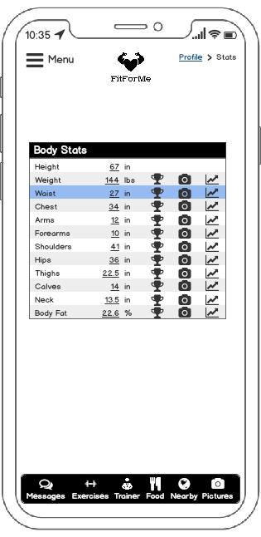
Capture Measurements
My Plan
Edit Profile
Capture Stats

Slide 23
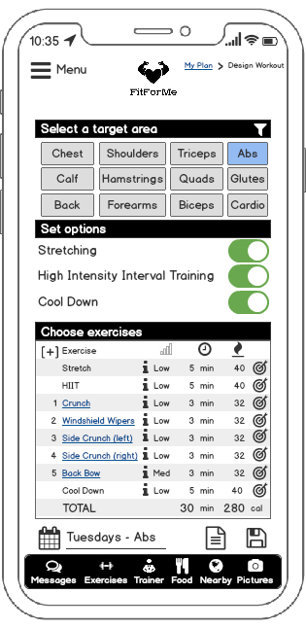
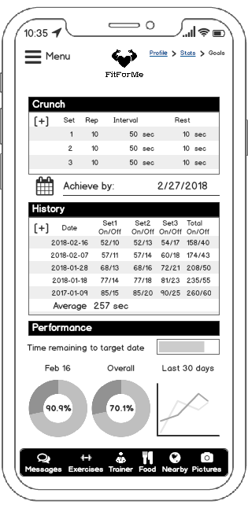
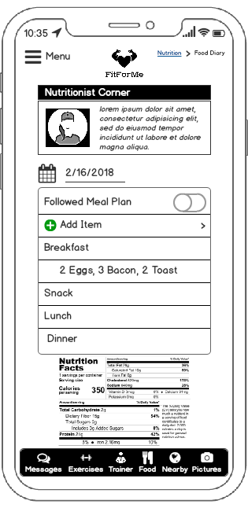
Design Workout & Track Food
Design Workout
Enter Goal
Record Food Intake

